Slide 1
MCM Modeling – Cohort Level
Version 1, October 2016
DO NOT MODIFY
REUSE OR COPY THE SLIDE(S) YOU NEED OR SAVE TO YOUR COMPUTER

Slide 2
Overview
MCM: Background of the topic
Datasources
Dat Flow
Modeling
Amgen Case
Deliverables
Notes:
To edit data in charts:
Right click on chart and select ‘Edit Data in Excel’. Add data or change Headlines in Microsoft Excel. Add new lines of data and remove where needed. The data is automatically updated in PowerPoint. Close Microsoft Excel after updating data (Saving is not necessary)

Slide 3
MCM - Background
MCM - Multi Channel Marketing
QuintilesIMS has ist own CRM-Software called Nexxus, in which clients execute and track their promotional activities: Sales representatives visits, Emails, Direct Mailings, etc.
Questions:
Can we better target HCPs based on the information we track in Nexxus & on clients side & we have internally at QuintilesIMS?
Which are the HCPs that are most responsive to certain channels? What is the most efficient channel for each HCP?
When do we target a certain HCP with which channel?
→ NBA: Next best action & NBC: Next best customer
Notes:
To edit data in charts:
Right click on chart and select ‘Edit Data in Excel’. Add data or change Headlines in Microsoft Excel. Add new lines of data and remove where needed. The data is automatically updated in PowerPoint. Close Microsoft Excel after updating data (Saving is not necessary)

Slide 4
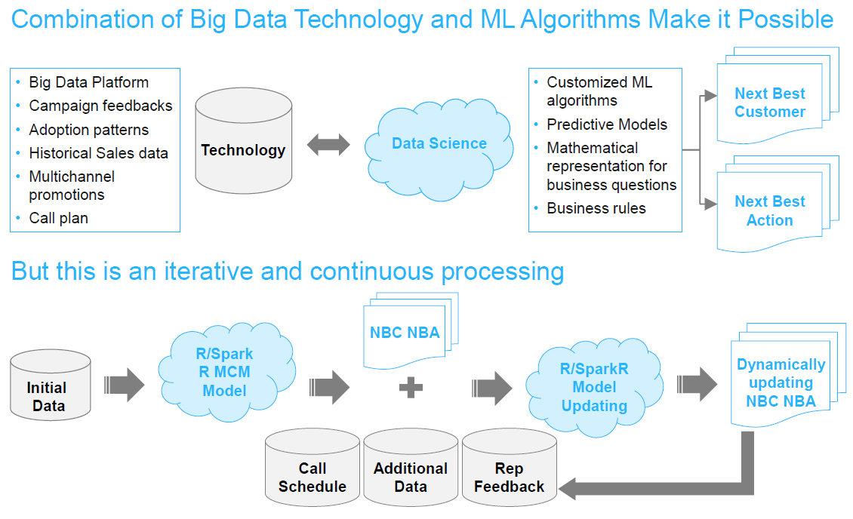
MCM – Vision for NBA/NBC
Notes:
To edit data in charts:
Right click on chart and select ‘Edit Data in Excel’. Add data or change Headlines in Microsoft Excel. Add new lines of data and remove where needed. The data is automatically updated in PowerPoint. Close Microsoft Excel after updating data (Saving is not necessary)

Slide 5
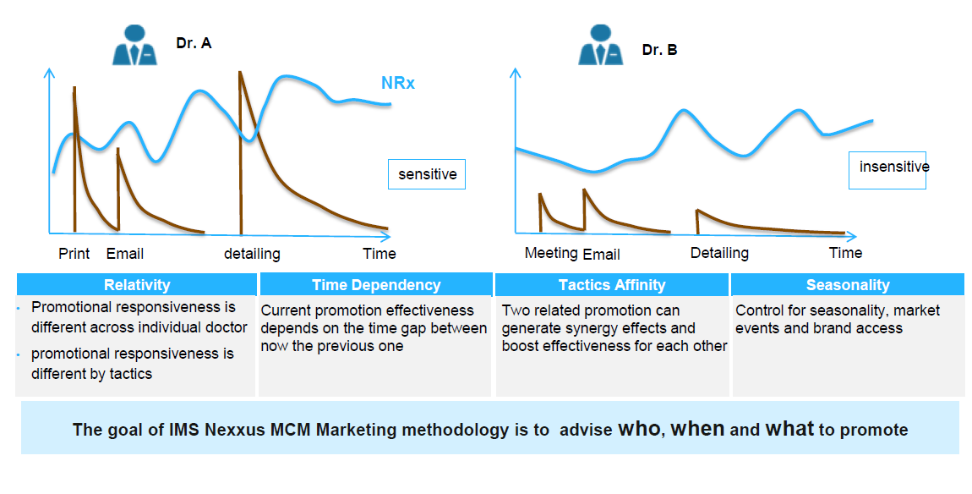
MCM Ideal scenario in US – Sales Data on HCP level
Notes:
To edit data in charts:
Right click on chart and select ‘Edit Data in Excel’. Add data or change Headlines in Microsoft Excel. Add new lines of data and remove where needed. The data is automatically updated in PowerPoint. Close Microsoft Excel after updating data (Saving is not necessary)

Slide 6
European reality due to Data Privacy
In Europe, we can only use sales data on aggregate level for analyses. Internally for validation we have some data on HCP-level, but this can not be used for offerings.
Notes:
To edit data in charts:
Right click on chart and select ‘Edit Data in Excel’. Add data or change Headlines in Microsoft Excel. Add new lines of data and remove where needed. The data is automatically updated in PowerPoint. Close Microsoft Excel after updating data (Saving is not necessary)

Slide 7
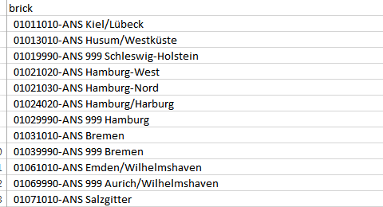
MCM Solution on aggregate level
We use Xponent data on nanobrick level: In Germany, we have about 12.050 Nanobricks, clustered by specialty and region. Premise: there have to at least 3 practices in each Nanobrick to not infer to HCP level.
Bricks from different specialty can overlap on geographical level
We know which HCP is located in which Nanobrick → Impacts of the channels on brick level are written to HCPs in that brick with contact to the channels
Internally we validate with prescriber data: Model on HCP-level based on a panel
Nanobrick_Nr
Specialty
Region
Notes:
To edit data in charts:
Right click on chart and select ‘Edit Data in Excel’. Add data or change Headlines in Microsoft Excel. Add new lines of data and remove where needed. The data is automatically updated in PowerPoint. Close Microsoft Excel after updating data (Saving is not necessary)

Slide 8
Data Sources and data flow
Monthly Xponent Product & competitor (ATC-Class) Sales data on Nanobrick level
Promotions of each channel with HCP ID, timestamp product information etc.
Further information on HCPs from oney key database: Nanobrick, Primary Specialty etc.
External information for special events&seasonality: Holidays, christmas, weather etc.
Example Data flow:
Aggregate on Nanobrick/month level
Join on Nanobrick/month level
One Key information
Join with One Key ID
Promotions
Promotions
Xponent Sales
Mixed Model Effects on Nanobrick level
Full Join with One Key ID
Full join effects & One Key by Nanobrick
Email Data
…
External information
Join on Nanobrick or month level
Effects on HCP level
Calls
Notes:
To edit data in charts:
Right click on chart and select ‘Edit Data in Excel’. Add data or change Headlines in Microsoft Excel. Add new lines of data and remove where needed. The data is automatically updated in PowerPoint. Close Microsoft Excel after updating data (Saving is not necessary)

Slide 9
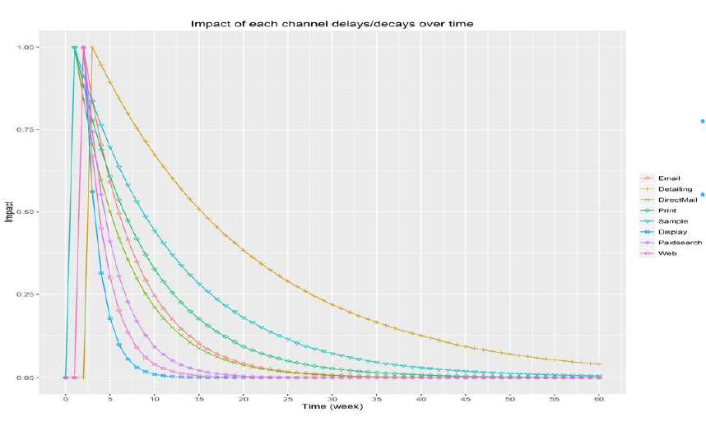
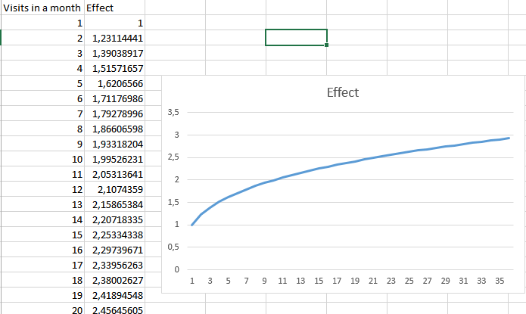
Software used and modeling parameters
We used R for the whole project. Standard manipulation packages like dplyr etc., lme4 for linear mixed modeling & Winbugs/ mcmc package in R for advanced parameter estimation.
Parameter components of the model: alpha and betas for each feature as impact, retention rate/Decay and roots.
Decay
→ Promotions in one month also have effects in the following periods
Roots
→ Diminishing returns of effect with further contacts to a achannel
Notes:
To edit data in charts:
Right click on chart and select ‘Edit Data in Excel’. Add data or change Headlines in Microsoft Excel. Add new lines of data and remove where needed. The data is automatically updated in PowerPoint. Close Microsoft Excel after updating data (Saving is not necessary)

Slide 10
Modeling procedure
Once we have the final df (all x & y on nanobrick level by month/time period), we normalize sales and promotions by nr. of HCPs in each brick → average sales and promotions for each HCP
Several further filterings are used that we need to go in detail at another session: filter by bricks with sales of product or competitor to decrease noise etc.
We transform the promotion data by decay & root factors we believe are reasonable and test a basic lme model specifying at least alpha as random effect. We optimize decay & root manually and test all other effects. Normally we use competitor sales (often positive effect as indicator of demand), linear trend and events/seasonality as non promotional features.
We use these decay & root factors + the alpha/betas as priors for MCMC estimation (Monte Carlo Marko Chain). Non reasonable effects (promotions have a negative effect for example) are adjusted
In the end we have all parametrs on Nanobrick level. We write those promotion effects to HCPs within that brick that had contact with the relevant channel
Notes:
To edit data in charts:
Right click on chart and select ‘Edit Data in Excel’. Add data or change Headlines in Microsoft Excel. Add new lines of data and remove where needed. The data is automatically updated in PowerPoint. Close Microsoft Excel after updating data (Saving is not necessary)

Slide 11
Amgen Case
Notes:
To edit data in charts:
Right click on chart and select ‘Edit Data in Excel’. Add data or change Headlines in Microsoft Excel. Add new lines of data and remove where needed. The data is automatically updated in PowerPoint. Close Microsoft Excel after updating data (Saving is not necessary)

Slide 12
Amgen Case Prolia – Sales vs. Promotions on aggregate level
Korr. Calls-VOs: 0,51444785
Notes:
To edit data in charts:
Right click on chart and select ‘Edit Data in Excel’. Add data or change Headlines in Microsoft Excel. Add new lines of data and remove where needed. The data is automatically updated in PowerPoint. Close Microsoft Excel after updating data (Saving is not necessary)

Slide 13
Model Comparison – Top 50 Bricks vs. Full Model
> summary(lmm)$coefficients
Estimate Std. Error t value
(Intercept) 3.2023456875 0.47250262 6.77741361
proliavo_wettb_norm 0.1533202374 0.06731480 2.27766021
lfnd_date 0.1229733276 0.01600541 7.68323459
summerbreak_1 -0.6432366143 0.15797636 -4.07172696
Prolia_calls_adj 0.5077628202 0.20835958 2.43695452 root: 0.540314222222222
Prolia_email_adj -0.0281628094 0.04554497 -0.61835171 root: 0.458874222222222
Prolia_dmail_adj -0.0006674169 0.01565664 -0.04262835 root: 0.431972222222222
> mean (model_df$mape)
[1] 0.2077492 MAPE
> 1 - sum( (model_df$sum_fitted - model_df$proliavo_norm)^2 ) / sum( (model_df$proliavo_norm-mean(model_df$proliavo_norm))^2 )
[1] 0.8334265 R²
> summary(lmm)$coefficients
Estimate Std. Error t value
(Intercept) 0.1463321870 0.0113680899 12.8721877
proliavo_wettb_norm 0.0665929816 0.0056665942 11.7518530
lfnd_date 0.0038427737 0.0003044040 12.6239263
summerbreak_1 -0.0350601220 0.0032803056 -10.6880657
Prolia_calls_adj 0.0368029366 0.0042125550 8.7364881
Prolia_email_adj 0.0099572046 0.0005509412 18.0730790 -> changing signs and significant effect due to sample size
Prolia_dmail_adj -0.0003029474 0.0004252561 -0.7123883
> mean (model_df$mape)
[1] 0.45 MAPE
> 1 - sum( (model_df$sum_fitted - model_df$proliavo_norm)^2 ) / sum( (model_df$proliavo_norm-mean(model_df$proliavo_norm))^2 )
[1] 0.9440976 R²
Notes:
To edit data in charts:
Right click on chart and select ‘Edit Data in Excel’. Add data or change Headlines in Microsoft Excel. Add new lines of data and remove where needed. The data is automatically updated in PowerPoint. Close Microsoft Excel after updating data (Saving is not necessary)

Slide 14
Top 50 Bricks Prolia: First Model
VOs
No final model
Bricks & month
One brick time series
Notes:
To edit data in charts:
Right click on chart and select ‘Edit Data in Excel’. Add data or change Headlines in Microsoft Excel. Add new lines of data and remove where needed. The data is automatically updated in PowerPoint. Close Microsoft Excel after updating data (Saving is not necessary)

Slide 15
Top 50 Bricks Prolia: First Model
VOs
No final model
→ Brick A
→ Brick B
→ Brick C
→ Jan-Nov 2016
→ Jan-Nov 2016
→ Jan-Nov 2016
Notes:
To edit data in charts:
Right click on chart and select ‘Edit Data in Excel’. Add data or change Headlines in Microsoft Excel. Add new lines of data and remove where needed. The data is automatically updated in PowerPoint. Close Microsoft Excel after updating data (Saving is not necessary)

Slide 16
Variation in Beta Calls by VO-Size
Tendency: The more sales in a brick, the bigger the effect of calls. But nice variation in effect size by brick.
Notes:
To edit data in charts:
Right click on chart and select ‘Edit Data in Excel’. Add data or change Headlines in Microsoft Excel. Add new lines of data and remove where needed. The data is automatically updated in PowerPoint. Close Microsoft Excel after updating data (Saving is not necessary)

Slide 17
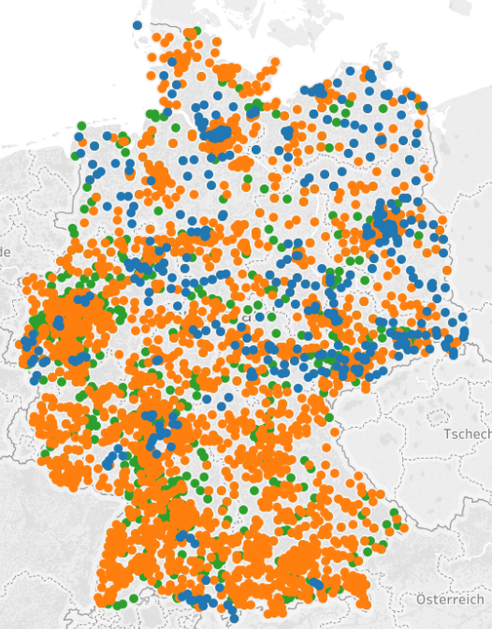
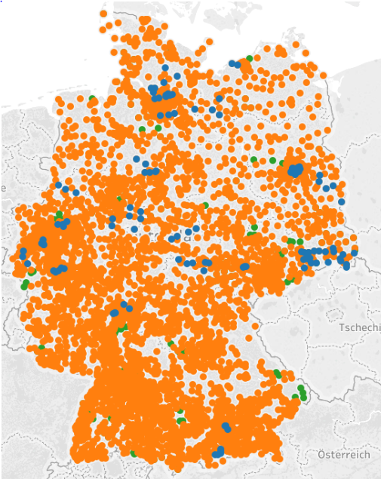
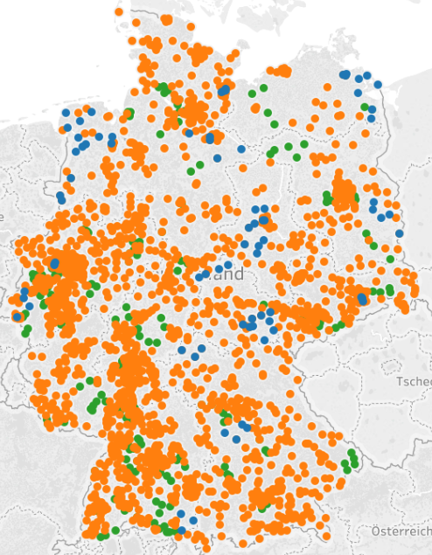

Example Deliverable: Channel Effectiveness by Zip
Calls
Email
Direct Mail

Slide 18
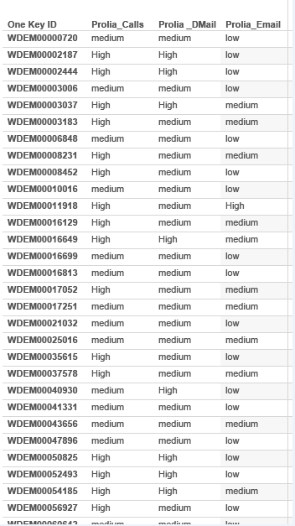
Example Deliverable: Channel Effectiveness by HCP

Slide 19
What’s is next?
We need to test the Xponent Model vs. Prescriber Model vs. Trustcenter Model (another method)
Clearing of R code, generalization to comfortably use for other cases
Handover the code to you for France project

